Slide 1
Distance Vector Routing Protocol

Slide 2
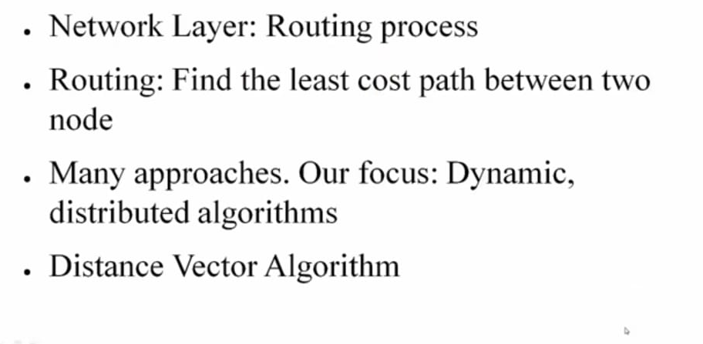

Slide 3
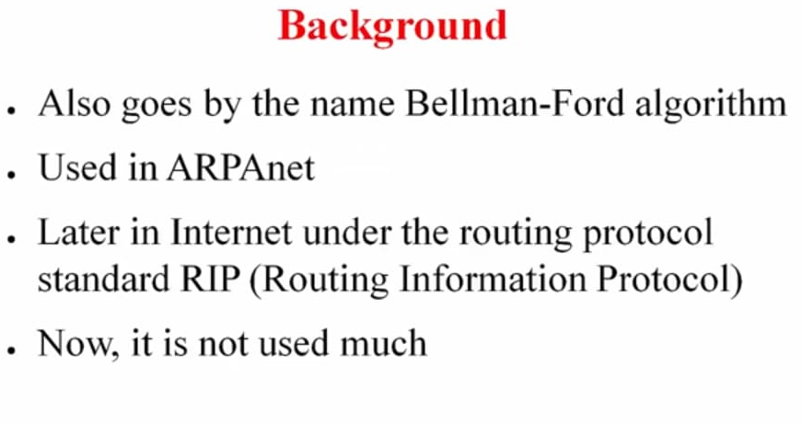

Slide 4
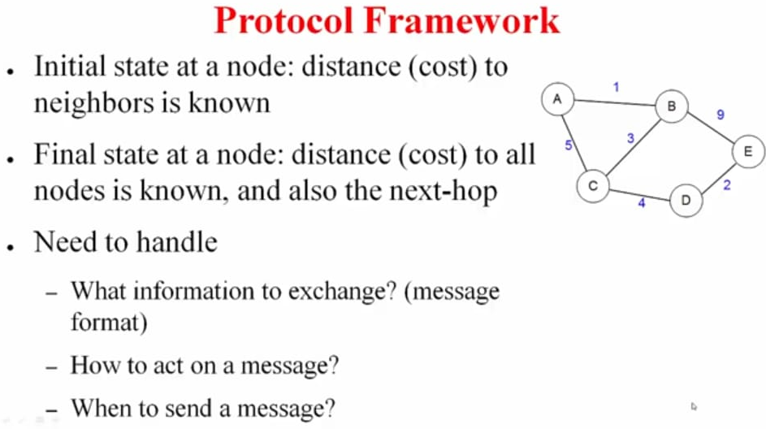

Slide 5
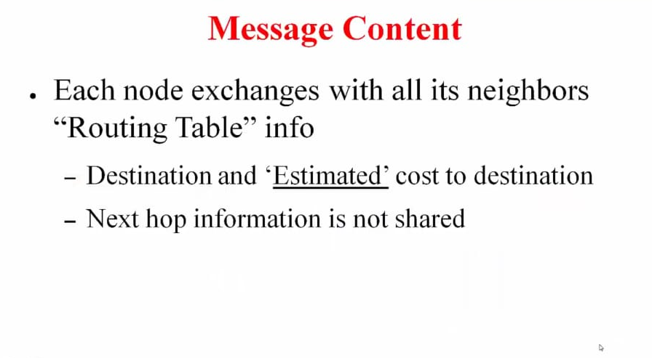

Slide 6
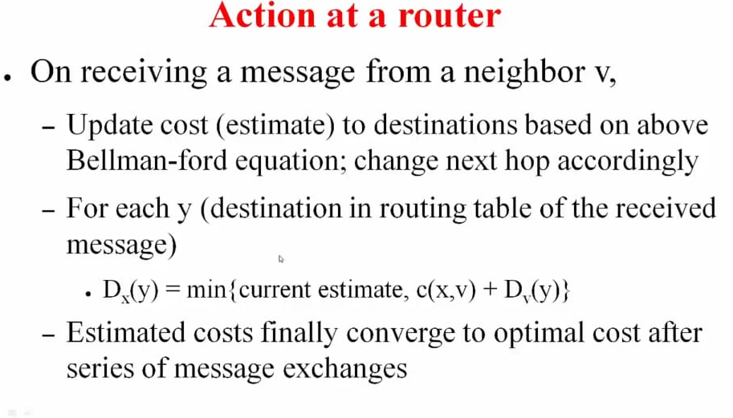

Slide 7
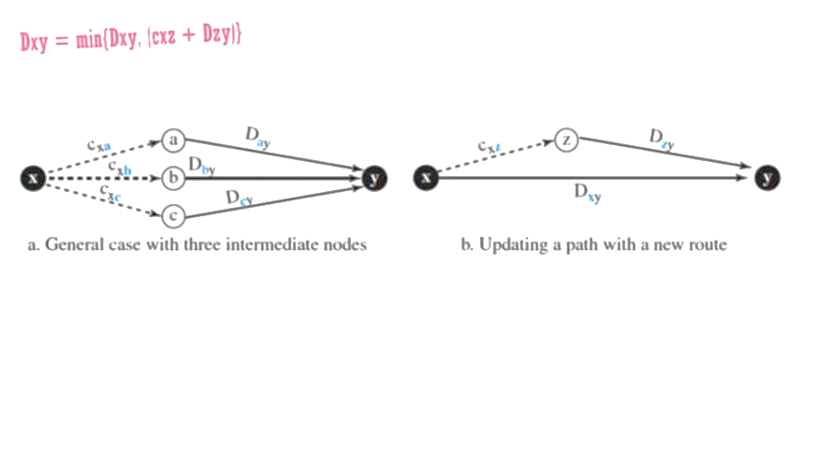

Slide 8
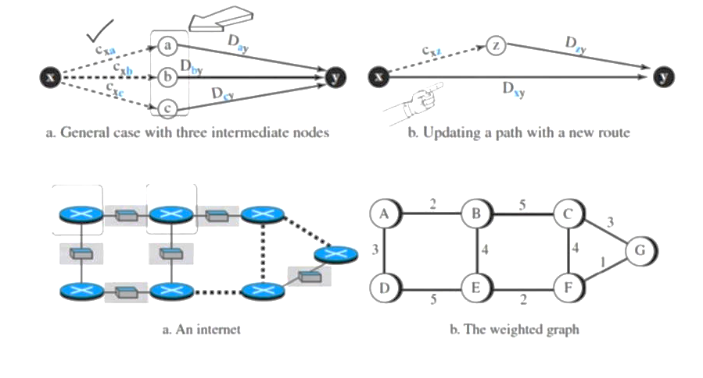

Slide 9
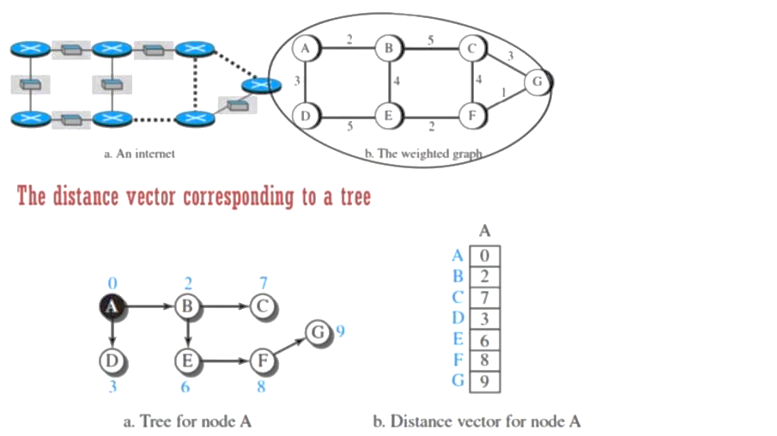

Slide 10
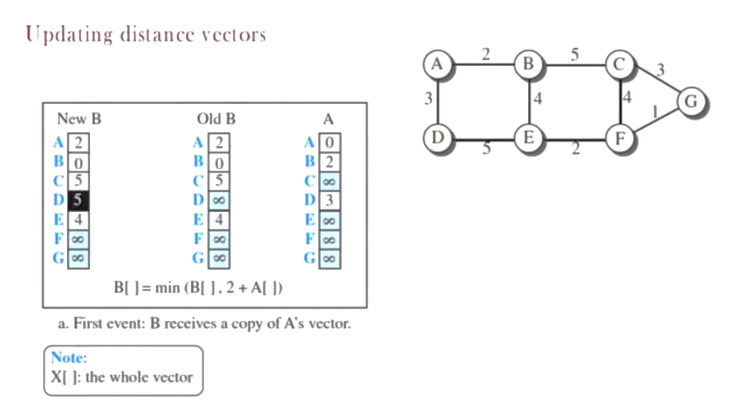

Slide 11
Steps to follow
Find the shortest path between source and the destination
Exchanging vectors to find the nodes with minimal cost
After updating the node it immediately send the update to all neighbor nodes.

Slide 12
